Slide 1
Code Search Engine
Marcus Stewart, Daniel Gilley, Arman Bahraini, Robert Wenger

Slide 2
Project Description and Requirements

Slide 3
Requirements
Web app
Allow to write textual queries
Search keywords from the query in a selected code repository from github
Visualize instances of the keywords, including:
File name
Author of the words
Revision date
Commit message

Slide 4
Requirements Cont.
Allow sorting of results, by:
File name
Author of the words
Revision date
Commit message
Allow exporting results to a downloadable file
Allow importing results from an uploadable file

Slide 5
Use Cases
Create query
Select a repository to search
Search a repository
Limit query to code changes or to commit messages
Filter results by time frame
Filter results by contributor
Visualization (expand result for more info)
Visualization (follow result to commit)

Slide 6
Use Cases Cont.
Refine existing query and update results
Sort results by file name
Sort results by author
Sort results by revision date
Sort results by commit message
Export results to file
Import results from file
Re-search query from imported file

Slide 7
Non-Functional Requirements
Web App
Return Results Quickly
Simple and Easy to Use
Visually Appealing

Slide 8
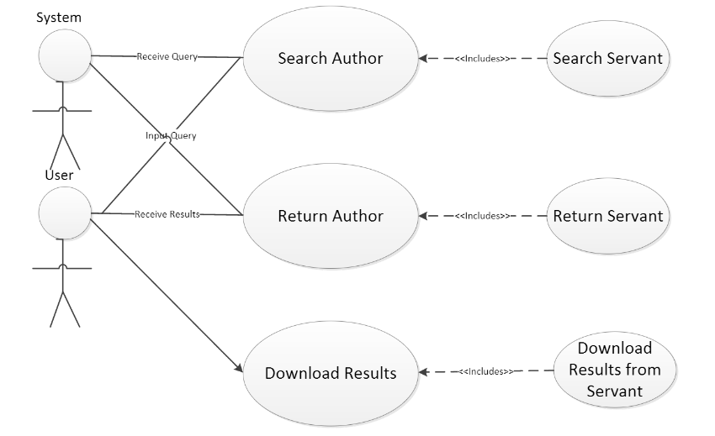
Use Case Diagram

Slide 9
High Level Design

Slide 10
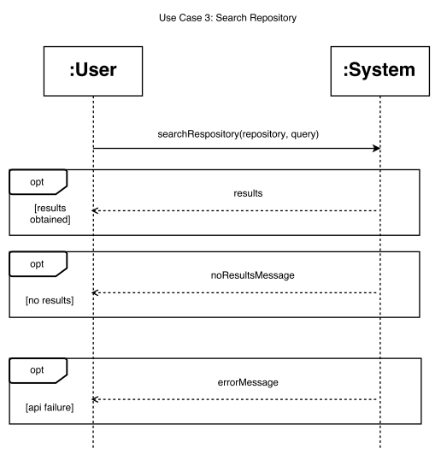
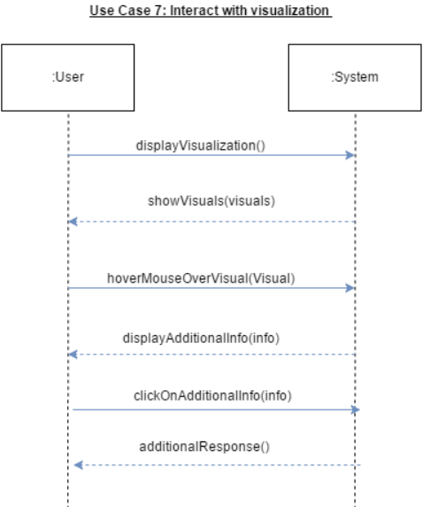

Slide 11
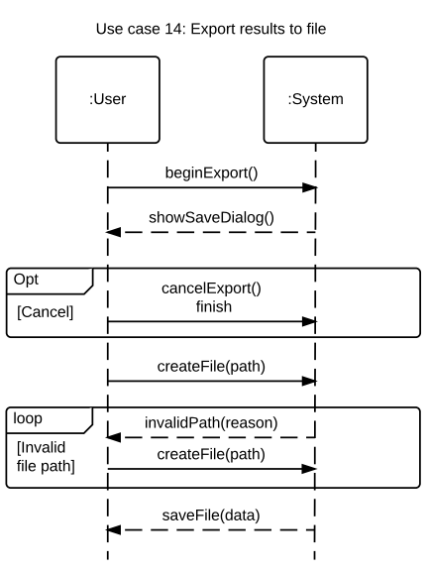
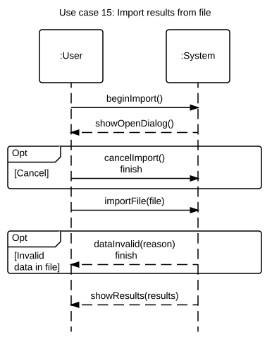

Slide 12
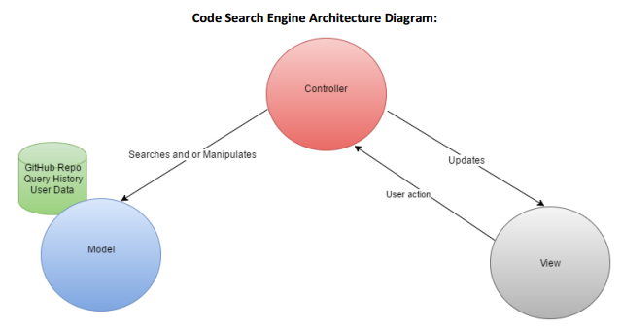

Slide 13
Detailed Design

Slide 14
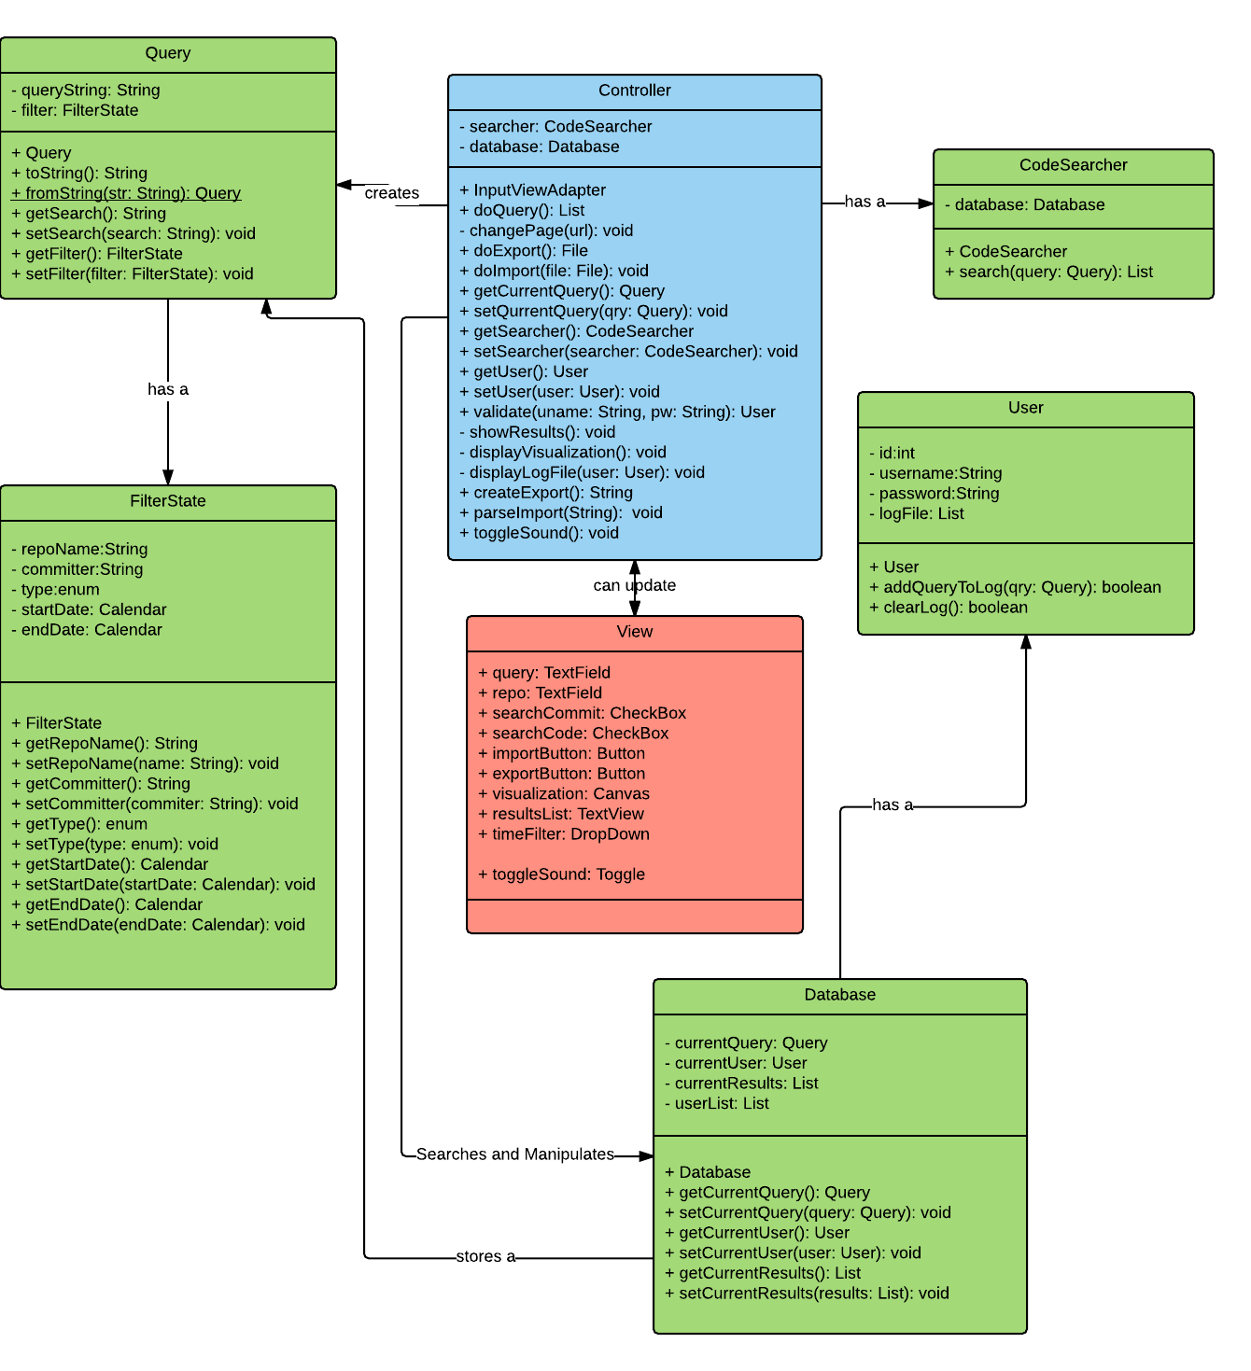
Class Diagram

Slide 15
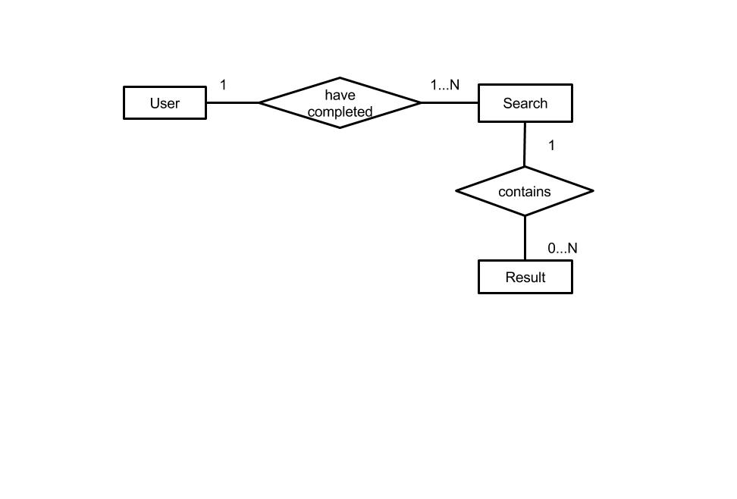
Database Diagram

Slide 16
Database Design
uid : integer, primary key | The ID number of the user.
username : varchar(30) | The username of the user
password : varchar(30) | The password of the user.
User
sid : integer, primary key | The ID number of the search.
query: text | The text representation of the query.
searchTime : Date | The time at which the search was executed.
uid : integer, foreign key from User | The ID of the user who executed the search.
Search
sid : integer, foreign key from Search | ID of the search that returned this result.
file : text | The file this result is contained in.
commitId: text | The commit the file is contained within.
lineNumber : integer | The line number containing this result.
line : text | The text of the line containing this result.
resultStart : integer | The character in the line at which this result begins.
Result

Slide 17
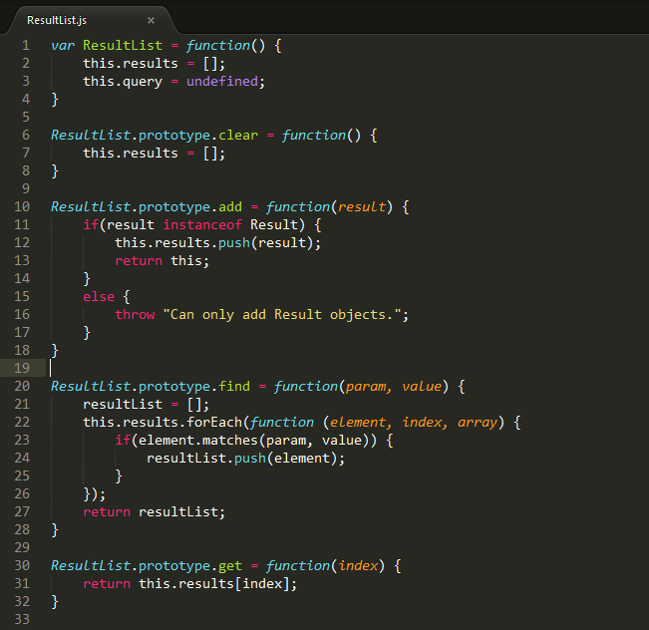
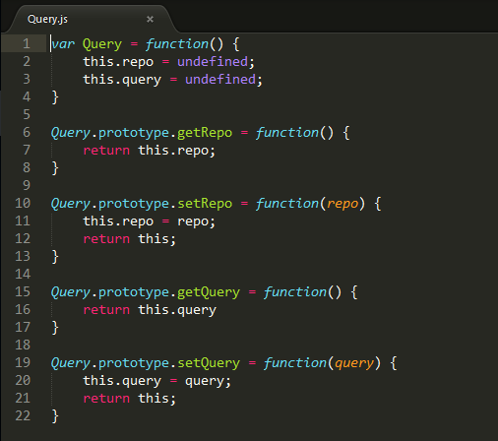
Implementation

Slide 18
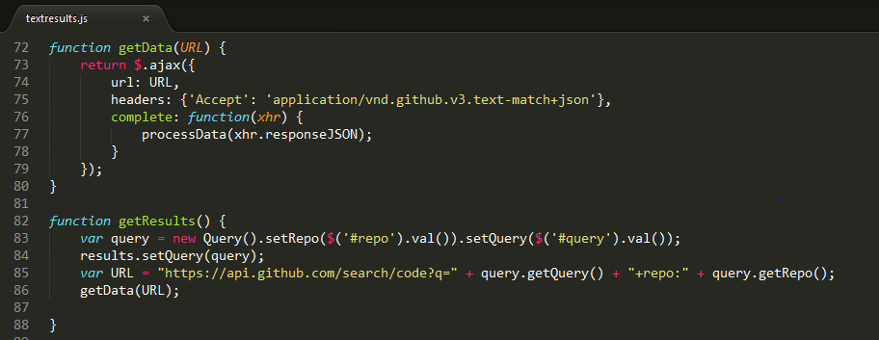
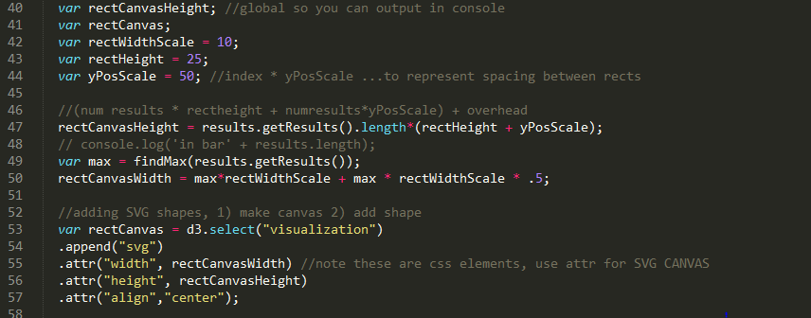
Implementation

Slide 19
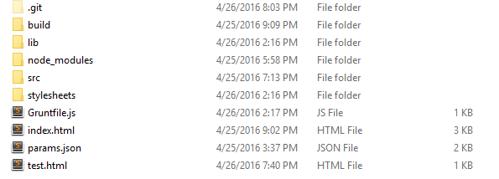
Libraries, Testing, and Build Tools
jQuery
D3
QUnit
Mockjax
Grunt

Slide 20
Demonstration

